Slide 1


Slide 2


Slide 3


Slide 4
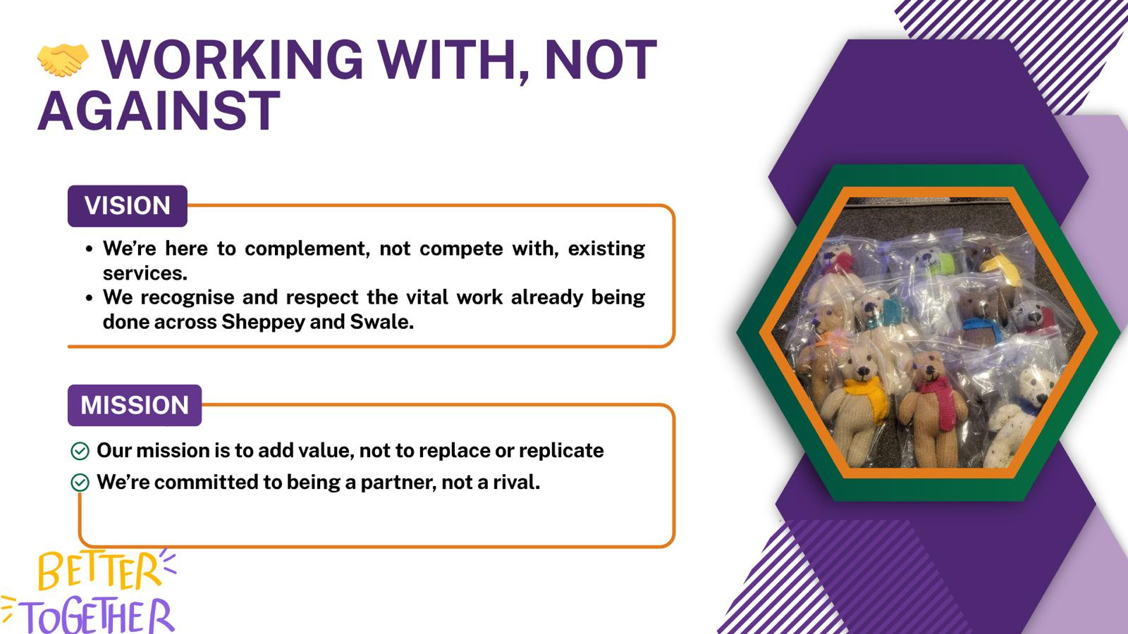

Slide 5


Slide 6


Slide 7


Slide 8






07553159049
https://www.sheppeypulsenetwork.co.uk/
staff@sheppeypulsenetwork.co.uk
https://www.facebook.com/groups/1066508681826290

